Slide 1
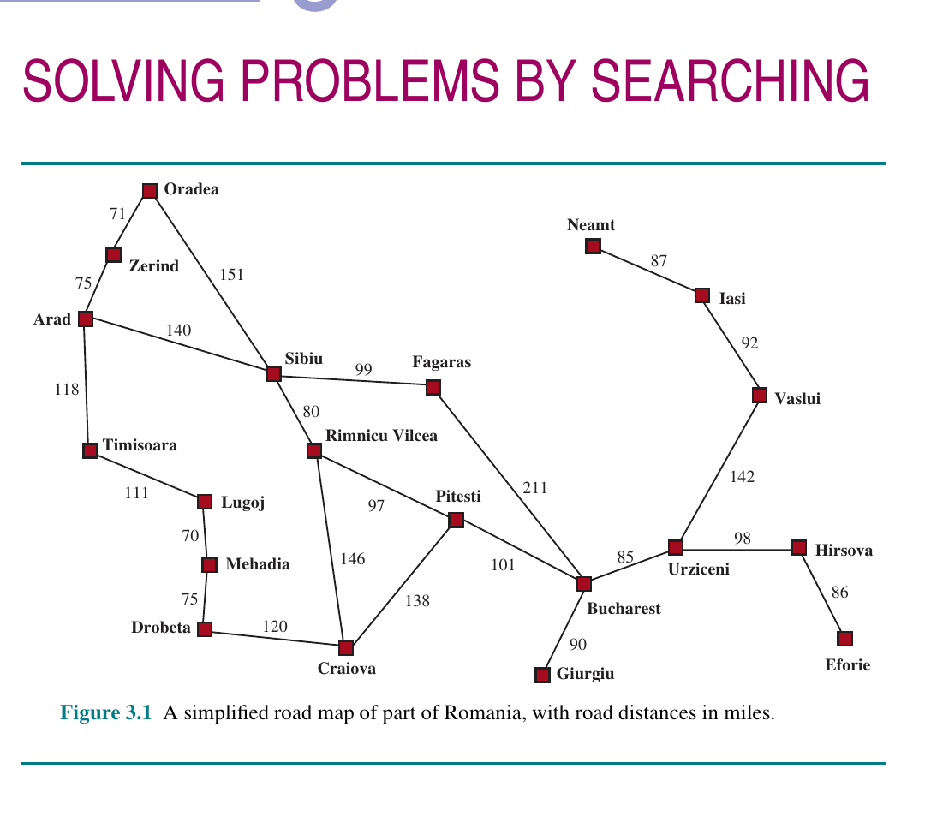
COMP 469
Solving Problems by Searching
Chapter 3 full lecture deck with examples, analogies, diagrams, and instructor speaker notes.
Search is the engine behind route-finding, puzzles, planning, and many classic AI systems.
California State University Channel Islands
Notes:
Teaching notes: Welcome students and frame the lecture around a question: when an intelligent agent does not know the right next action, what can it do? The answer in Chapter 3 is search: simulate possible action sequences before acting in the real world.
Analogy: A GPS does not try every road physically. It builds a map model, explores possible routes mentally, and then gives you a sequence of turns. That is the core idea of problem-solving agents.
Emphasize that this chapter is foundational. Chapters 4 and 5 make search harder by relaxing assumptions and adding uncertainty or adversaries; Chapters 7 onward change the representation of knowledge.

Slide 2
CHAPTER 3
Where Chapter 3 Fits in COMP 469
Ch. 1
Ch. 2
Ch. 3
Ch. 4+
What is AI? Rational action
Agents, environments, PEAS
Search for action sequences
Complex environments and uncertainty
Chapter 3 changes the question from "what is an agent?" to "how can an agent look ahead?"
COMP 469 | Chapter 3: Solving Problems by Searching
02
Notes:
Teaching notes: Remind students that Chapter 2 gave us the agent vocabulary: sensors, actuators, percepts, performance measures, and environment properties. Chapter 3 is the first major mechanism for choosing actions.
Use the bridge: if an agent has a goal and a model of actions, it can search over possible futures. This is an early, classic view of AI: problem solving as finding a path through a state space.
Make sure students understand that search is not just for games or maps. It appears in robotics, scheduling, puzzle solving, theorem proving, planning, and optimization.

Slide 3
CHAPTER 3
Learning Outcomes
• Formulate a search problem using states, actions, transition model, goals, and costs.
• Explain the difference between a state-space graph and a search tree.
• Compare uninformed strategies: BFS, UCS, DFS, depth-limited, iterative deepening, bidirectional.
• Use g(n), h(n), and f(n) to explain greedy best-first search and A-star search.
• Evaluate search algorithms by completeness, optimality, time, and memory.
• Design and critique heuristics for the 8-puzzle and route-finding problems.
Instructor cue: keep returning to the same three questions: What is being expanded? What is on the frontier? What guarantee do we get?
COMP 469 | Chapter 3: Solving Problems by Searching
03
Notes:
Teaching notes: Treat this slide as the contract for the lecture. Tell students that by the end, they should be able to trace an algorithm by hand and explain why one strategy is better than another in a given situation.
This is also a useful assessment list. If a student can define a problem, trace frontier changes, and defend an algorithm choice, they have understood the chapter at a university level.
Mention that the labs reinforce each bullet: the route-planning GUI, search tree/frontier lab, uninformed search lab, heuristic search lab, and 8-puzzle heuristic lab.

Slide 4
CHAPTER 3
The Big Analogy: Search Is Mental Simulation
• Before acting, the agent imagines possible action sequences.
• Each imagined world state becomes a node in a search tree.
• The frontier is the agent's current "to investigate next" list.
• A solution is a path from the initial state to a goal state.
• An optimal solution is the cheapest such path.
Search = simulate futures, then execute one chosen path.
Student question: If the agent can search before acting, why not search everything? That leads directly to complexity: the number of possible futures grows explosively.
COMP 469 | Chapter 3: Solving Problems by Searching
04
Notes:
Teaching notes: Use an everyday analogy before introducing formal definitions. Suppose you are leaving campus and need to get to an airport. You do not start driving randomly. You compare routes in your head or on a GPS.
The key phrase is mental simulation. In Chapter 3, the agent has a model of how actions change the state. Search is the process of using that model to look ahead.
Analogy: The frontier is like browser tabs you have opened but not read yet. Expanding a node is clicking one tab and discovering more links to add to the tab list.

Slide 5
CHAPTER 3
Roadmap for Today
• Part 1: Problem-solving agents and problem formulation.
• Part 2: Generic best-first search, nodes, frontier, and reached states.
• Part 3: Uninformed strategies and their tradeoffs.
• Part 4: Informed search with heuristics, greedy search, and A-star.
• Part 5: How to invent and evaluate heuristic functions.
• Part 6: Lab connections, practice prompts, and teaching checks.
Anchor idea: search algorithms differ mostly by their frontier policy.
COMP 469 | Chapter 3: Solving Problems by Searching
05
Notes:
Teaching notes: Give students the structure up front. This chapter can feel like a list of algorithms, so the roadmap prevents fragmentation.
Tell students the organizing principle: every algorithm is mainly a different rule for deciding which frontier node to expand next.
Make the recurring vocabulary explicit: state, action, result, path cost, node, frontier, reached, evaluation function.

Slide 6
PART 1
Problem-Solving Agents
From goals to formal search problems.
Chapter 3
COMP 469 | Chapter 3: Solving Problems by Searching
06
Notes:
Teaching notes: Transition from broad AI agents to problem-solving agents. A problem-solving agent is not just reacting. It is using a model to select a sequence of actions.
Analogy: A chef does not just grab a random ingredient. A chef has a goal, a model of recipes, and a plan. Search is what happens when the correct recipe is not immediately obvious.

Slide 7
CHAPTER 3
Why Search?
• The correct action is not always obvious from the current percept.
• The agent may need a sequence of actions, not a single reflex.
• The agent can use a model to simulate possible futures.
• A good search process avoids trying dangerous or expensive actions in the real world.
• Search converts "what should I do now?" into "what path reaches the goal?"
Search is useful when the next action only makes sense in light of future consequences.
COMP 469 | Chapter 3: Solving Problems by Searching
07
Notes:
Teaching notes: Start with a simple question: If you are in Arad and need to reach Bucharest, should you go to Sibiu, Timisoara, or Zerind? Without a map, the action is hard to choose.
Search becomes useful when local information is insufficient. The agent must look ahead.
Analogy: Search is like previewing chess moves before touching the piece. Even though Chapter 3 is single-agent, the idea of looking ahead will return in adversarial search in Chapter 5.

Slide 8
CHAPTER 3
Chapter 3 Assumptions
• Single agent: no opponent is trying to block us.
• Fully observable: the agent knows the current state.
• Deterministic: actions have predictable results.
• Static: the world does not change while the agent plans.
• Discrete: states and actions can be enumerated.
• Known: the agent has a model of available actions and their effects.
Under these assumptions, a solution can be a fixed action sequence: an open-loop plan.
COMP 469 | Chapter 3: Solving Problems by Searching
08
Notes:
Teaching notes: Make this slide very explicit. Many student misconceptions come from assuming Chapter 3 handles all real-world complexity. It does not.
Use the phrase training wheels. Chapter 3 gives us the cleanest version of search. Later chapters remove the training wheels: unknown maps, noisy sensors, nondeterministic actions, adversaries, and partial observability.
Analogy: This is like planning a road trip using a perfect map, no traffic, no road closures, and a car that always does exactly what you tell it to do.

Slide 9
CHAPTER 3
Problem-Solving Agent Cycle
Goal formulation
Problem formulation
Search
Execution
Choose what matters now.
Represent states, actions, goals, and costs.
Simulate possible action sequences.
Carry out the selected solution path.
Good AI begins before the algorithm: it begins with the right abstraction.
COMP 469 | Chapter 3: Solving Problems by Searching
09
Notes:
Teaching notes: This slide mirrors the four-phase process from the chapter. Use the Romania example: goal formulation is deciding that reaching Bucharest is the current objective; problem formulation is simplifying the world into cities and roads; search explores routes; execution follows the selected route.
Analogy: Before writing an essay, you choose the topic, create an outline, compare possible structures, then write. Search is the outline-comparison stage.
Warn students that formulation is not busywork. A bad formulation can make the problem unsolvable or much harder than necessary.

Slide 10
CHAPTER 3
Formal Search Problem Components
• State space: all possible states the environment can be in.
• Initial state: where the agent starts.
• Goal test: determines whether a state satisfies the goal.
• Actions(s): legal actions available in state s.
• Result(s, a): the state produced by taking action a.
• Action cost c(s, a, s'): numeric cost of the step.
Search algorithm = domain-independent. Problem formulation = domain-specific.
COMP 469 | Chapter 3: Solving Problems by Searching
10
Notes:
Teaching notes: This is the core definition slide. Tell students that almost every algorithm later assumes these pieces exist.
Use the phrase "API of a search problem." The algorithm does not need to know what a city or puzzle tile really is; it only calls Actions, Result, Is-Goal, and Action-Cost.
Analogy: A search problem is like a board game rulebook. Once the rules define legal moves and winning states, different players can use different strategies.

Slide 11
CHAPTER 3
Paths, Solutions, and Optimality
solution = path(initial state -> goal state)
A path is a sequence of actions. A solution reaches a goal. An optimal solution has the lowest total path cost among all solutions.
Cost is additive in this chapter: total path cost is the sum of step costs.
COMP 469 | Chapter 3: Solving Problems by Searching
11
Notes:
Teaching notes: Keep the difference between solution and optimal solution clear. A route from Arad to Bucharest through Fagaras is a solution; it may not be the cheapest solution.
Ask students: Is any path to the goal good enough? In some applications yes, such as emergency response where speed of planning matters. In others, such as fuel-limited robotics, optimality matters.
Connect to performance measures from Chapter 2. Optimality is only meaningful relative to a cost function.

Slide 12
CHAPTER 3
Abstraction: The Art of Leaving Things Out
• A state should include the details needed to solve the problem.
• A state should omit irrelevant details that explode complexity.
• For route finding, "current city" may be enough.
• For driving a real car, weather, traffic, and road closures may matter.
• A useful abstraction is valid and easy to execute.
Good abstraction removes as much detail as possible without breaking the solution.
COMP 469 | Chapter 3: Solving Problems by Searching
12
Notes:
Teaching notes: Abstraction is one of the most important ideas in the chapter. A good abstraction makes search possible.
Analogy: A subway map is not geographically accurate, but it is useful because it preserves the information riders need: stations and connections. That is an abstraction.
Ask students for examples of details that are irrelevant for a Romania route search: music, exact tire pressure, passenger conversation. Then ask for details that might become relevant in a different formulation: traffic, road closures, gas range.

Slide 13
CHAPTER 3
Example 1: Romania Route Finding
• States: cities such as Arad, Sibiu, Bucharest.
• Actions: drive from one city to an adjacent city.
• Result: the next city reached after the drive.
• Cost: road distance in miles.
• Goal: reach Bucharest.
Figure source: uploaded Chapter 3 image PDF, Figure 3.1.
COMP 469 | Chapter 3: Solving Problems by Searching
13
Notes:
Teaching notes: Use the map as the main recurring example. Students can understand this intuitively, which makes it ideal for algorithm tracing.
Ask: From Arad, which three actions are available? Students should say Sibiu, Timisoara, and Zerind. Then ask: without looking ahead, which should we choose? This motivates search.
Emphasize that the map is a state-space graph: cities are states and roads are actions in both directions.

Slide 14
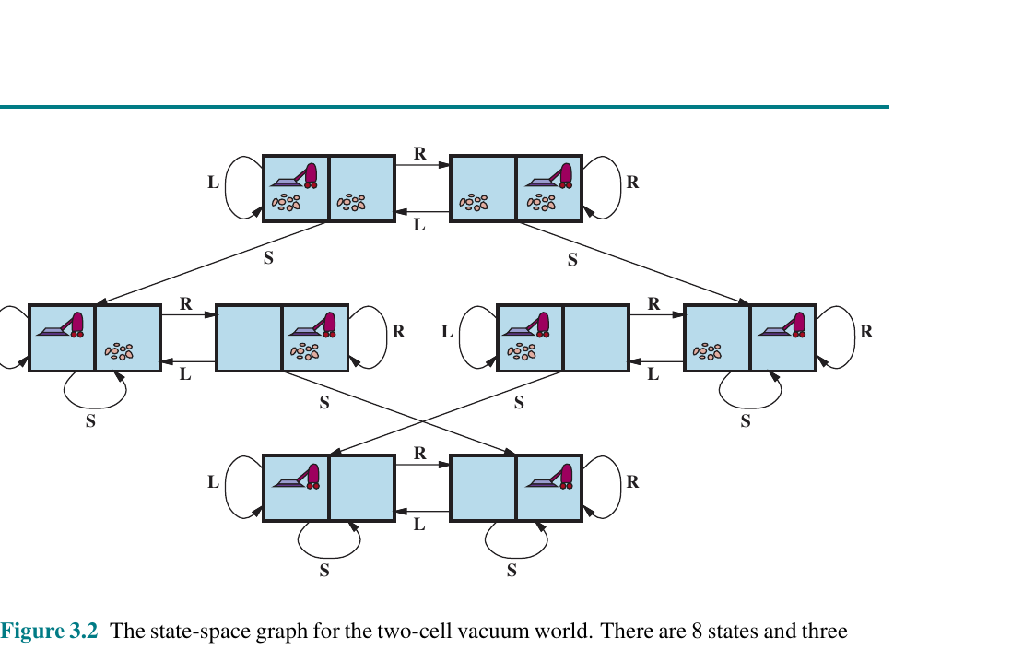
CHAPTER 3
Example 2: Two-Cell Vacuum World
• States include the agent location and dirt status.
• Actions: Left, Right, Suck.
• A tiny world can still have a nontrivial state-space graph.
• Useful for connecting Chapter 2 agents to Chapter 3 search.
• Shows that "simple" does not mean "no structure."
Figure source: uploaded Chapter 3 image PDF, Figure 3.2.
COMP 469 | Chapter 3: Solving Problems by Searching
14
Notes:
Teaching notes: Connect back to the Chapter 2 vacuum world. In Chapter 2, students built agents that reacted or kept models. In Chapter 3, we can formulate the same world as a search problem.
Ask: What is the goal? Usually both squares clean. What is the cost? Maybe one per action. What is the solution? A sequence like Suck, Right, Suck depending on the initial state.
Analogy: Even a two-room apartment has multiple possible histories: where the vacuum is, which rooms are dirty, and what action comes next.

Slide 15
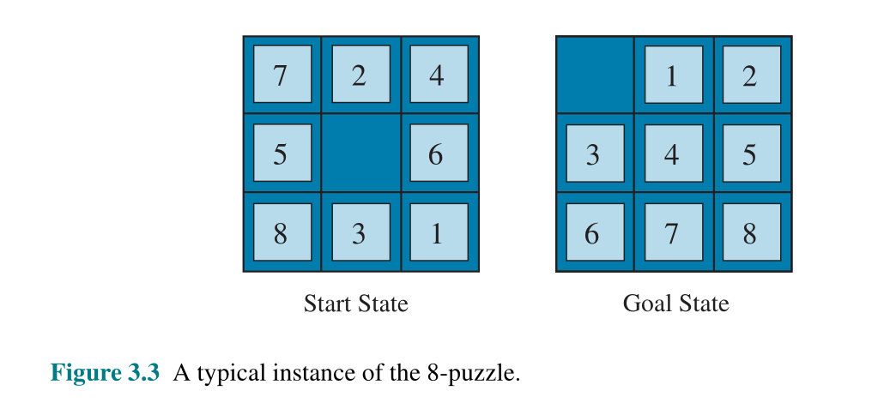
CHAPTER 3
Example 3: The 8-Puzzle
• States: tile configurations.
• Actions: slide a tile into the blank space.
• Goal: match the target configuration.
• Cost: usually one per move.
• Great benchmark for studying heuristic quality.
Figure source: uploaded Chapter 3 image PDF, Figure 3.3.
COMP 469 | Chapter 3: Solving Problems by Searching
15
Notes:
Teaching notes: The 8-puzzle is the key heuristic example later in the chapter. It is small enough to visualize but hard enough to show exponential growth.
Ask students to identify what changes after one action: only the blank and one neighboring tile move. This helps them see why the transition model matters.
Analogy: The puzzle is like organizing a crowded desk where you can only move one item into the empty space at a time. The constraints create the search difficulty.

Slide 16
CHAPTER 3
Standardized vs. Real-World Problems
Standardized problems
Real-world problems
• Concise, exact descriptions.
• Useful for comparing algorithms.
• Examples: 8-puzzle, vacuum world, grid worlds, route maps.
• Usually small enough to analyze carefully.
• Formulations are messy and domain-specific.
• Examples: route planning, robot navigation, VLSI layout, scheduling.
• Costs may include time, money, energy, risk, or comfort.
• Abstraction and data quality matter as much as the algorithm.
COMP 469 | Chapter 3: Solving Problems by Searching
16
Notes:
Teaching notes: This slide helps students see why textbook examples matter. Standardized problems are not toys because they teach transferable algorithmic ideas.
Analogy: Pilots learn in simulators before flying passengers. Standardized problems are the simulators of search.
Mention that modern navigation apps, logistics systems, game AI, and robotics all use search-like ideas, often with much more engineering around them.

Slide 17
PART 2
Search Trees, Frontiers, and Data Structures
The same state space can produce many different search trees.
Chapter 3
COMP 469 | Chapter 3: Solving Problems by Searching
17
Notes:
Teaching notes: Transition from problem formulation to the mechanics of search. The next few slides explain what the algorithm actually stores and manipulates.
Key distinction: a state-space graph is the world model; a search tree is the algorithm's exploration history. Students often confuse these.

Slide 18
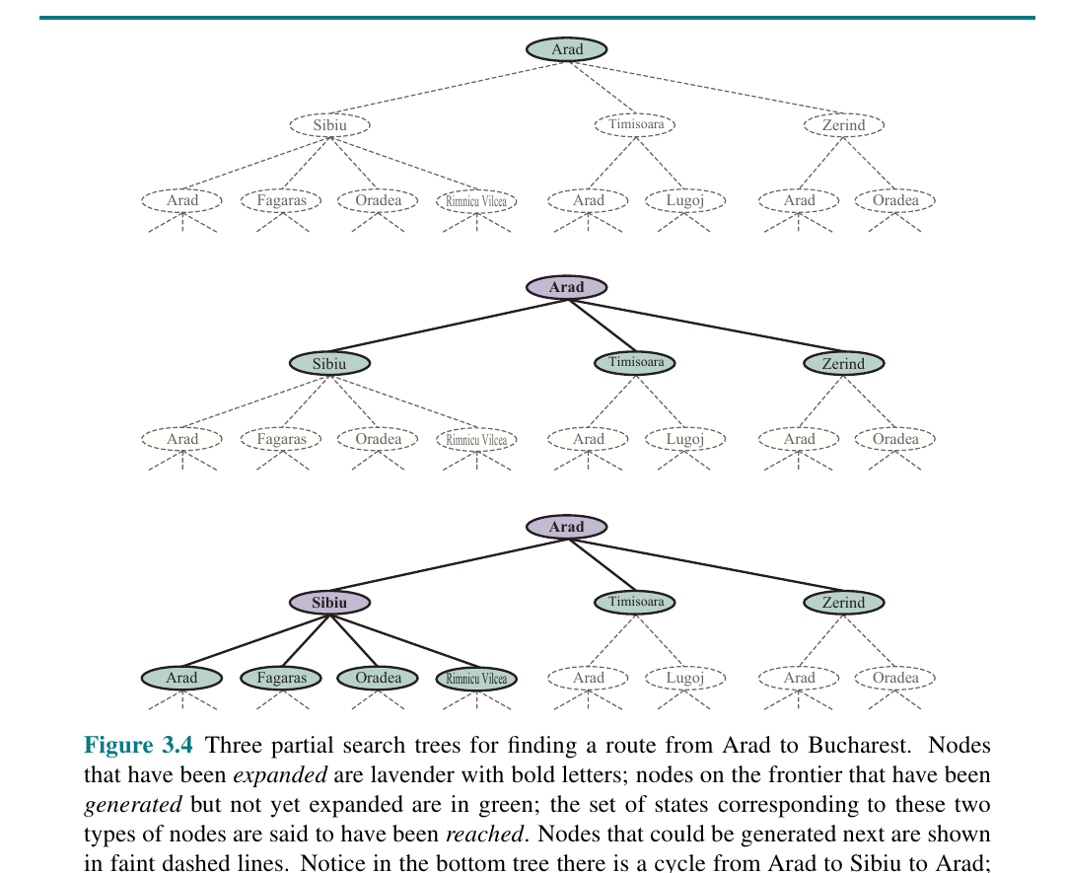
CHAPTER 3
State-Space Graph vs. Search Tree
• State-space graph: each distinct world state appears once.
• Search tree: a state may appear multiple times through different paths.
• Nodes are not just states; they include path information.
• The tree grows as the algorithm explores possible action sequences.
Figure source: uploaded Chapter 3 image PDF, Figure 3.4.
COMP 469 | Chapter 3: Solving Problems by Searching
18
Notes:
Teaching notes: Use the image to show that Arad can appear again below Sibiu because the agent could drive back to Arad. That duplicate is a path issue, not a new city.
Analogy: The state-space graph is a map; the search tree is your notebook of possible trips. The same city can appear several times in your notebook if reached by different routes.
This is the right moment to introduce why cycle checking and reached tables matter.

Slide 19
CHAPTER 3
What Is Stored in a Search Node?
• State: where the node is in the state space.
• Parent: pointer to the previous node.
• Action: the action that generated this node.
• Path cost g(n): cost from the initial state to this node.
• Depth: number of actions from the root.
A node is a bookkeeping object. A state is a world configuration.
COMP 469 | Chapter 3: Solving Problems by Searching
19
Notes:
Teaching notes: This is a simple but crucial data structure. A state alone is not enough because the agent must reconstruct the solution path.
Analogy: A breadcrumb trail. The current location tells you where you are; the parent pointers let you walk back and recover how you got there.
Ask: Why store the parent instead of storing the entire path in every node? Answer: memory efficiency. You can reconstruct the path by following parent pointers backward.

Slide 20
CHAPTER 3
Frontier and Reached Table
• Frontier: nodes generated but not yet expanded.
• Reached table: states already seen, usually with their best known path cost.
• Expanding a node removes it from the frontier and generates successors.
• The frontier policy determines the search strategy.
• Reached states prevent redundant paths and cycles.
Every search strategy answers: which frontier node should I expand next?
COMP 469 | Chapter 3: Solving Problems by Searching
20
Notes:
Teaching notes: This is the main vocabulary students need for tracing algorithms. The frontier is the live edge of exploration.
Analogy: The frontier is a restaurant waitlist of tables to check next. Different algorithms sort the waitlist differently: first-come first-served, cheapest first, deepest first, or most promising first.
Ask students: In BFS, what kind of data structure should the frontier be? Answer: FIFO queue. In DFS? Stack. In UCS or A-star? Priority queue.

Slide 21
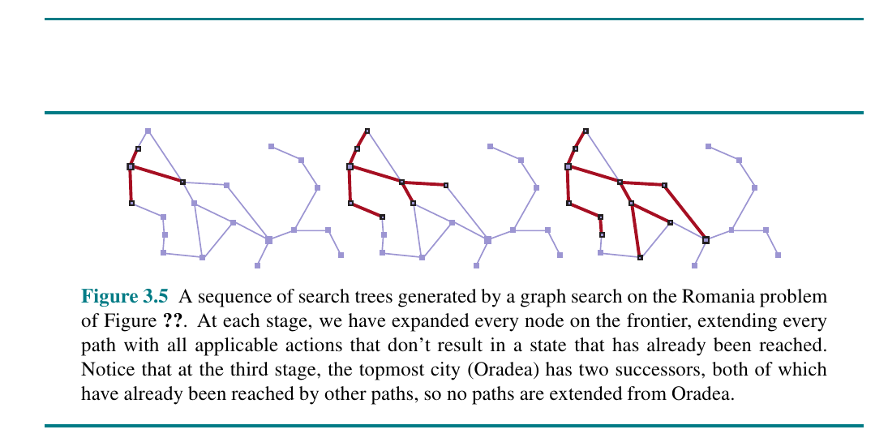
CHAPTER 3
Redundant Paths and Cycles
• Graphs can contain multiple paths to the same state.
• Without checking, search may repeat expensive work.
• Cycles can make algorithms loop forever.
• Reached tables turn tree search into graph search.
• For optimal algorithms, reached must respect path cost.
Figure source: uploaded Chapter 3 image PDF, Figure 3.5.
COMP 469 | Chapter 3: Solving Problems by Searching
21
Notes:
Teaching notes: Use this slide to explain why naive search wastes time. In Romania, Arad to Sibiu to Arad is a valid path but not useful.
Analogy: If you are exploring a building, you mark rooms you have already checked. Otherwise you might walk in circles and believe the building is much larger than it is.
Important nuance: If a cheaper path to a reached state is later found, algorithms such as uniform-cost search and A-star may need to update the reached entry.

Slide 22
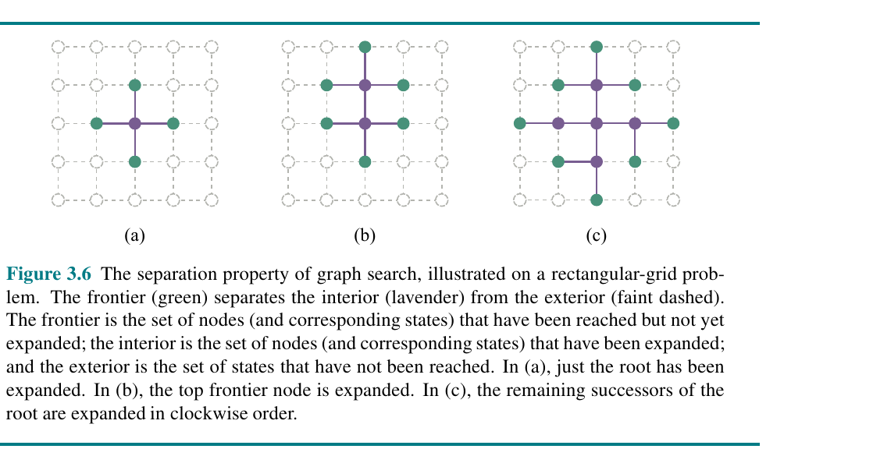
CHAPTER 3
The Separation Property
• The frontier separates explored interior from unreached exterior.
• Useful for reasoning about graph search behavior.
• Interior: expanded states.
• Frontier: reached but unexpanded states.
• Exterior: states not reached yet.
Figure source: uploaded Chapter 3 image PDF, Figure 3.6.
COMP 469 | Chapter 3: Solving Problems by Searching
22
Notes:
Teaching notes: This picture is a visual anchor for graph search. The frontier is not just a list; it is a boundary between what the algorithm already knows and what it has not touched.
Analogy: Imagine search as pouring ink through a maze. The wet edge of the ink is the frontier.
Use this to explain why frontier size drives memory: if the boundary gets huge, the algorithm needs a lot of memory even if it has not expanded every state yet.

Slide 23
CHAPTER 3
Measuring Search Performance
• Completeness: will it find a solution if one exists?
• Cost optimality: will it find the cheapest solution?
• Time complexity: how many nodes are generated or expanded?
• Space complexity: how many nodes must be stored?
• Solution quality: exact optimum or good enough?
No algorithm wins on every criterion. The environment and goal determine the right tradeoff.
COMP 469 | Chapter 3: Solving Problems by Searching
23
Notes:
Teaching notes: These four criteria are the grading rubric for search algorithms. Make students apply them every time a new strategy appears.
Analogy: Picking a search algorithm is like picking transportation. Walking is cheap but slow; flying is fast but expensive; GPS gives good routes but needs data. Each choice has tradeoffs.
Clarify that time and space are often expressed in terms of b, the branching factor, and d, the depth of the shallowest goal.

Slide 24
PART 3
Generic Best-First Search
One framework, many search strategies.
Chapter 3
COMP 469 | Chapter 3: Solving Problems by Searching
24
Notes:
Teaching notes: Best-first search is the unifying abstraction. Instead of memorizing many algorithms as unrelated, students should see each as a different evaluation function or frontier ordering rule.
Frame it as a template method: keep a frontier, pick the best node according to f, expand it, repeat.

Slide 25
CHAPTER 3
Best-First Search: The Template
• Maintain a frontier ordered by an evaluation function f(n).
• Pop the node with the best f value.
• Goal test the selected node.
• Expand it to generate child nodes.
• Update frontier and reached states if a better path is found.
The evaluation function is the personality of the search algorithm.
COMP 469 | Chapter 3: Solving Problems by Searching
25
Notes:
Teaching notes: Use this as the master algorithm. Almost every later strategy can be explained by the choice of f(n).
Examples: BFS can be seen as expanding lowest depth first. UCS uses f(n) = g(n). Greedy uses f(n) = h(n). A-star uses f(n) = g(n) + h(n).
Analogy: Best-first search is a hiring committee. The evaluation function is the scoring rubric; the frontier is the applicant pool; expansion is interviewing one candidate and discovering referrals.

Slide 26
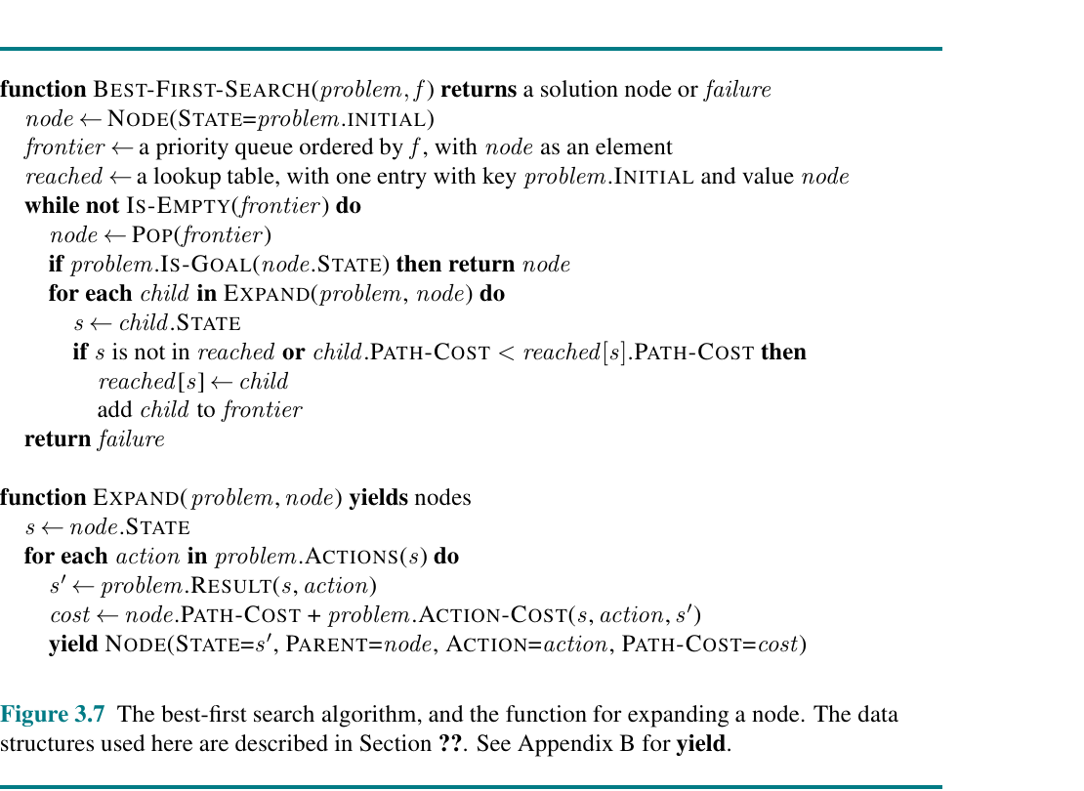
CHAPTER 3
Best-First Search Pseudocode
• The frontier is a priority queue ordered by f.
• Reached is a lookup table from state to best known node.
• EXPAND applies each legal action.
• The same skeleton supports many algorithms.
Figure source: uploaded Chapter 3 image PDF, Figure 3.7.
COMP 469 | Chapter 3: Solving Problems by Searching
26
Notes:
Teaching notes: Do not read the entire pseudocode line by line. Instead, point to the key structures: priority queue, reached table, goal test, expansion.
Ask students to identify what would change for uniform-cost versus A-star. The answer should be only the evaluation function and perhaps the heuristic availability.
Teaching trick: Cover the function name and ask students to infer the algorithm from the data structures.

Slide 27
CHAPTER 3
Expansion Mechanics
Pop node
Goal test
Generate children
Update records
Choose one frontier node by the strategy.
Check whether its state satisfies the goal.
Apply every applicable action.
Add or improve frontier/reached entries.
For classroom tracing: expanded node -> generated children -> new frontier ordering.
COMP 469 | Chapter 3: Solving Problems by Searching
27
Notes:
Teaching notes: This operational slide is useful before students trace algorithms. Make sure they know when the goal test happens, because variants can differ.
Analogy: Expanding a node is like opening one folder in a file cabinet. Inside are more folders. Some get added to the search pile, some are ignored because you already found a better copy.
Tell students that hand-tracing should always record three things: expanded node, frontier after expansion, and reached states.

Slide 28
CHAPTER 3
The Three Scores You Must Know
g(n) h(n) f(n)
g(n) is the cost so far. h(n) is the estimated cost to go. f(n) is the priority score used to choose what to expand next.
A-star combines past cost and future estimate: f(n) = g(n) + h(n).
COMP 469 | Chapter 3: Solving Problems by Searching
28
Notes:
Teaching notes: This is the vocabulary slide for informed search, but introduce it early. The notation will appear constantly.
Analogy: Planning a road trip: g(n) is miles already driven, h(n) is your estimate of miles remaining, and f(n) is the total expected trip length.
Important: h(n) is not available in uninformed search. A heuristic is domain knowledge supplied to the algorithm.

Slide 29
PART 4
Uninformed Search Strategies
When the agent has no estimate of distance to the goal.
Chapter 3
COMP 469 | Chapter 3: Solving Problems by Searching
29
Notes:
Teaching notes: Define uninformed search as search with access only to the problem definition. The algorithm knows actions, results, goal test, and costs, but has no special hint about where the goal is.
Analogy: Uninformed search is like looking for a book in a library without a catalog. You can still search systematically, but you lack guidance.

Slide 30
CHAPTER 3
Breadth-First Search (BFS)
• Expands the shallowest unexpanded nodes first.
• Frontier data structure: FIFO queue.
• Complete if branching factor is finite.
• Optimal when all action costs are equal.
• Main weakness: exponential memory usage.
BFS is fair: it never ignores shallow possibilities.
COMP 469 | Chapter 3: Solving Problems by Searching
30
Notes:
Teaching notes: BFS is often students' first graph search algorithm. The intuitive idea is expanding in waves.
Analogy: Dropping a pebble in water. The ripples expand outward one distance level at a time.
Ask: Why is BFS optimal only when all step costs are equal? If one road costs 100 and another costs 1, shallowest path is not necessarily cheapest.

Slide 31
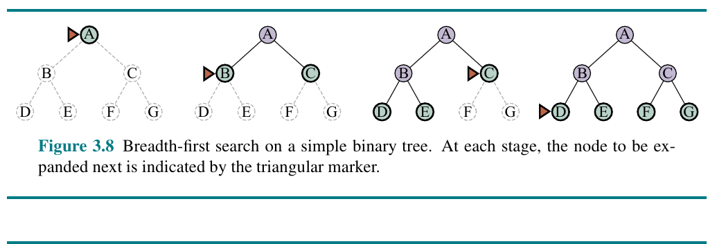
CHAPTER 3
BFS Visual: Level-by-Level Expansion
• BFS explores depth 0, then depth 1, then depth 2.
• The triangular marker shows the next node to expand.
• If the goal is shallow, BFS can find it quickly.
• If the tree is wide, memory grows fast.
Figure source: uploaded Chapter 3 image PDF, Figure 3.8.
COMP 469 | Chapter 3: Solving Problems by Searching
31
Notes:
Teaching notes: Use the image to trace the order A, B, C, D, E, F, G on a binary tree.
Ask students to name the frontier after expanding A. Then after expanding B. This checks whether they understand FIFO ordering.
Analogy: BFS is like checking everyone one handshake away, then everyone two handshakes away, and so on.

Slide 32
CHAPTER 3
BFS Strengths and Costs
• Strength: simple, complete, and depth-optimal for unit costs.
• Strength: excellent when goals are shallow.
• Cost: stores the whole frontier at the deepest generated level.
• Worst-case time: O(b^d).
• Worst-case space: O(b^d).
BFS often fails from memory before it fails from time.
COMP 469 | Chapter 3: Solving Problems by Searching
32
Notes:
Teaching notes: Students may think BFS is always good because it is complete and optimal for unit costs. Emphasize memory.
Use a numerical example: if b = 10 and d = 6, the frontier can be around one million nodes. At d = 10, it becomes enormous.
Analogy: BFS is like sending a search party in every direction equally. It is thorough, but the number of searchers grows explosively.

Slide 33
CHAPTER 3
Uniform-Cost Search (UCS)
• Expands the node with the lowest path cost g(n).
• Equivalent to best-first search with f(n) = g(n).
• Finds optimal-cost paths with positive step costs.
• Handles nonuniform action costs better than BFS.
• Can expand many cheap detours before reaching the goal.
Use UCS when path cost matters and no heuristic is available.
COMP 469 | Chapter 3: Solving Problems by Searching
33
Notes:
Teaching notes: Explain that UCS is essentially Dijkstra's algorithm for implicit state spaces. It expands outward by cost contours, not by depth.
Analogy: BFS counts number of turns; UCS counts actual miles or dollars. If road lengths differ, UCS is the more responsible driver.
Important detail: UCS is complete if action costs are bounded below by a positive epsilon. Otherwise infinitely many tiny-cost actions can cause trouble.

Slide 34
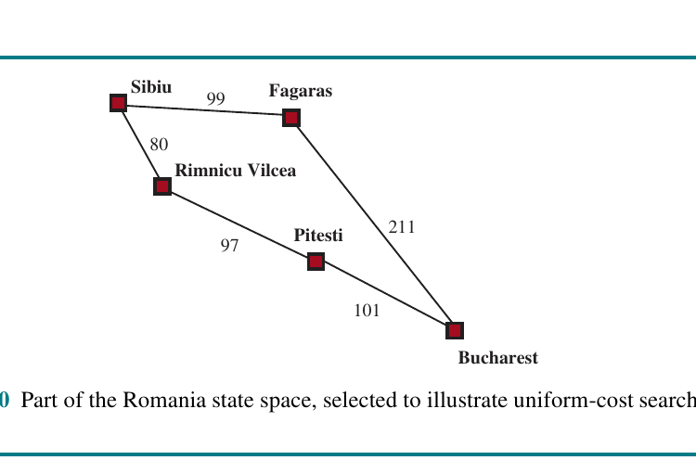
CHAPTER 3
UCS on a Romania Subgraph
• The cheapest partial path is expanded first.
• A short-looking route may not be cheapest.
• The algorithm delays commitment until costs prove the best path.
• This is why UCS is optimal for positive costs.
Figure source: uploaded Chapter 3 image PDF, Figure 3.10.
COMP 469 | Chapter 3: Solving Problems by Searching
34
Notes:
Teaching notes: Use the subgraph to contrast path length in steps with road distance. A path with fewer edges can still cost more.
Ask: Which path from Sibiu toward Bucharest looks direct? Then ask which path is cheaper when distances are added.
Analogy: Cheapest airline route is not always fewest flights. Sometimes a layover saves money; UCS is willing to consider that.

Slide 35
CHAPTER 3
BFS vs. UCS
Breadth-first search
Uniform-cost search
• Orders frontier by depth.
• Treats every action as equal cost.
• Optimal only for equal step costs.
• Often easier to explain and trace.
• Memory grows exponentially with solution depth.
• Orders frontier by path cost g(n).
• Handles variable action costs.
• Optimal with positive action costs.
• Can spend time on many low-cost side paths.
• Also memory-intensive.
COMP 469 | Chapter 3: Solving Problems by Searching
35
Notes:
Teaching notes: This comparison helps students avoid a common mistake: using BFS for weighted problems.
Analogy: BFS asks "How many steps?" UCS asks "How much total cost?" If every step costs the same, those questions align. If not, they diverge.
Quick check: Give two paths, one with 2 edges costing 100 each and one with 4 edges costing 1 each. Ask which algorithm prefers which path.

Slide 36
CHAPTER 3
Depth-First Search (DFS)
• Expands the deepest unexpanded node first.
• Frontier data structure: stack or recursion.
• Very low memory compared with BFS.
• Not cost-optimal.
• Not complete in infinite-depth spaces or with cycles unless carefully controlled.
DFS saves memory by risking bad commitments.
COMP 469 | Chapter 3: Solving Problems by Searching
36
Notes:
Teaching notes: DFS is the opposite personality from BFS: it commits deeply to one path before trying alternatives.
Analogy: Exploring a cave by always taking the first unexplored tunnel until you hit a dead end, then backtracking.
Students often like DFS because it is simple and memory-light. Make the danger clear: it can go very deep in the wrong direction and miss a shallow solution for a long time.

Slide 37
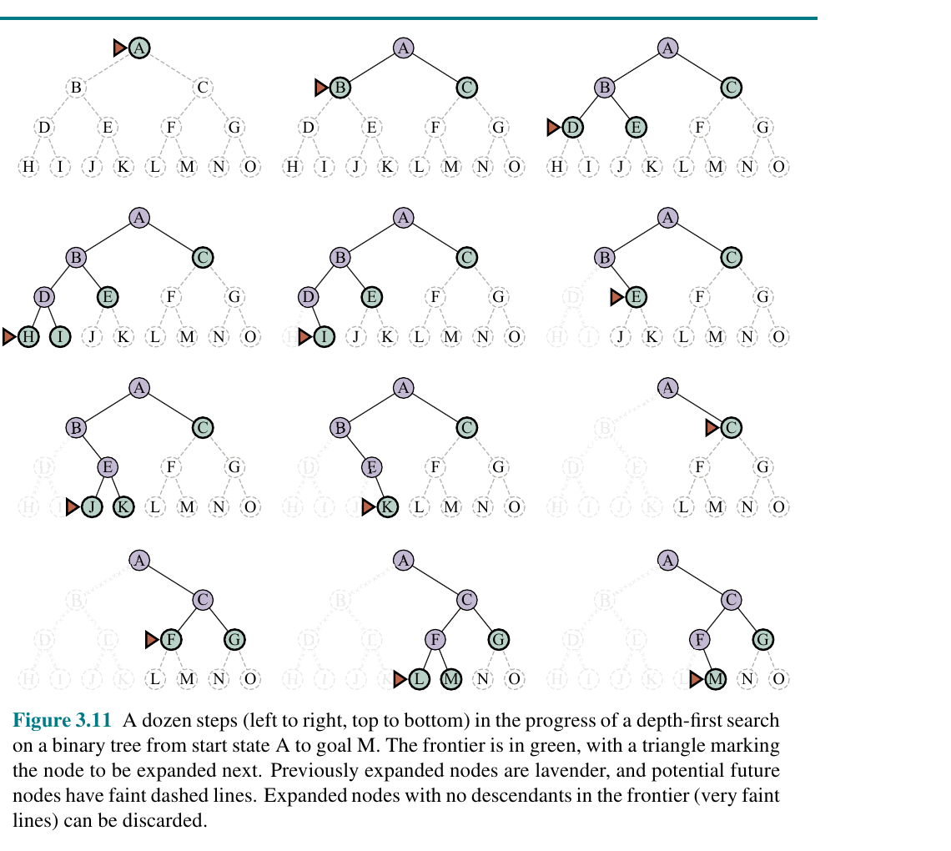
CHAPTER 3
DFS Visual: Deep Before Wide
• DFS follows one branch until it cannot continue.
• Backtracking returns to the most recent unexplored choice.
• Memory can be only O(bm) for tree search.
• But expansion order can be terrible if the first branch is bad.
Figure source: uploaded Chapter 3 image PDF, Figure 3.11.
COMP 469 | Chapter 3: Solving Problems by Searching
37
Notes:
Teaching notes: Use the figure to emphasize depth-first behavior. Point out how large parts of the tree fade while the current path is pursued.
Analogy: DFS is like reading footnotes within footnotes before returning to the original paragraph.
Ask students: If the goal were on the far right shallow branch, would DFS find it quickly? Usually not, depending on child ordering.

Slide 38
CHAPTER 3
Depth-Limited Search
• DFS with a maximum depth limit l.
• Prevents infinite descent.
• Can miss solutions deeper than the limit.
• Useful when we have a meaningful depth bound.
• Returns either success, failure, or cutoff.
The limit solves one problem but creates another: choosing l.
COMP 469 | Chapter 3: Solving Problems by Searching
38
Notes:
Teaching notes: Depth-limited search is a safety rail for DFS. It acknowledges that DFS can wander forever.
Analogy: When searching a website, you might say: follow links only three clicks deep. That prevents getting lost, but you might miss something useful deeper down.
Explain the three outcomes: success means a solution was found; failure means there is no solution within the explored part; cutoff means the limit stopped the search and a deeper solution might exist.

Slide 39
CHAPTER 3
Iterative Deepening Search (IDS)
• Runs depth-limited search with limits 0, 1, 2, ... until a goal is found.
• Combines BFS-like completeness with DFS-like memory.
• Repeated work near the root is usually not too costly.
• Preferred uninformed method when solution depth is unknown and memory is limited.
• Optimal for unit action costs with full cycle checking.
IDS is the practical compromise: complete like BFS, memory-light like DFS.
COMP 469 | Chapter 3: Solving Problems by Searching
39
Notes:
Teaching notes: Students often object: "Isn't repeating work wasteful?" Answer: yes, but the bottom level dominates the node count in exponential trees.
Analogy: Searching a building by first checking rooms next to the entrance, then restarting and allowing two steps, then three. Rechecking near the entrance is minor compared with the huge number of rooms far away.
This is a key algorithmic insight: a small amount of repeated shallow work can buy major memory savings.

Slide 40
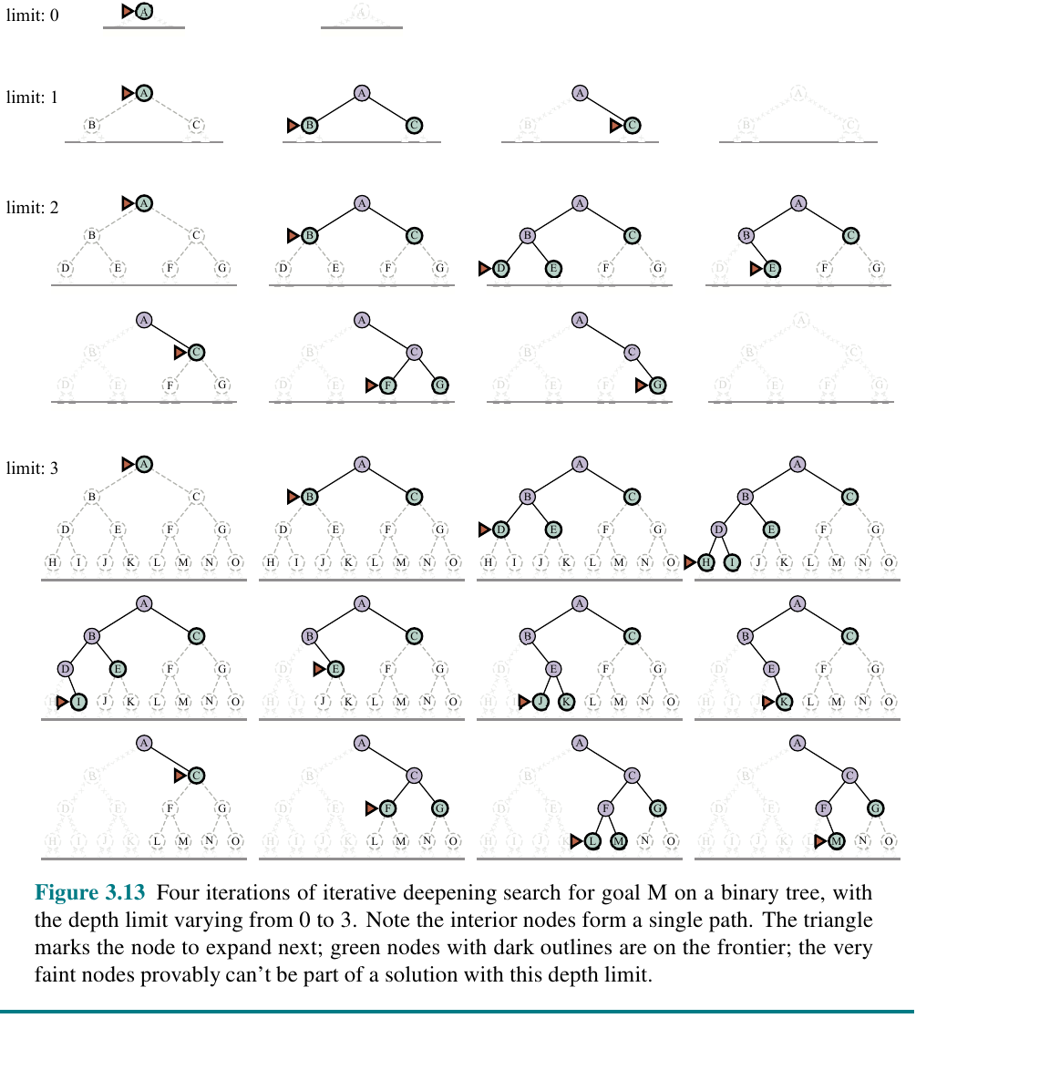
CHAPTER 3
IDS Visual: Increasing the Depth Horizon
• Limit 0: only the root.
• Limit 1: root and one move.
• Limit 2: two moves deep.
• Limit 3: reaches deeper goals.
• Each round is a bounded DFS.
Figure source: uploaded Chapter 3 image PDF, Figure 3.13.
COMP 469 | Chapter 3: Solving Problems by Searching
40
Notes:
Teaching notes: Use the phrase depth horizon. Each iteration pushes the search horizon one level farther.
Ask students: Why doesn't repeated expansion of the root dominate? Because in a branching tree, the number of nodes grows rapidly at the bottom levels.
Analogy: A flashlight with increasing range. Each pass sees a little farther into the cave.

Slide 41
CHAPTER 3
Bidirectional Search
• Searches forward from the initial state and backward from the goal.
• Stops when the two frontiers meet.
• Can reduce time from about O(b^d) to O(b^(d/2)).
• Requires a way to generate predecessors or reverse actions.
• Most useful when the goal is explicit and reverse search is feasible.
Meet in the middle can be exponentially cheaper.
COMP 469 | Chapter 3: Solving Problems by Searching
41
Notes:
Teaching notes: Bidirectional search is one of the easiest algorithms to explain visually. Two waves of search meet in the middle.
Analogy: Two people in a maze start from opposite entrances and call out when they meet. Each person walks much less distance than one person searching the whole maze.
Caveat: It is not always applicable. If the goal is "any clean configuration" or "any board with a checkmate," reverse search may be difficult.

Slide 42
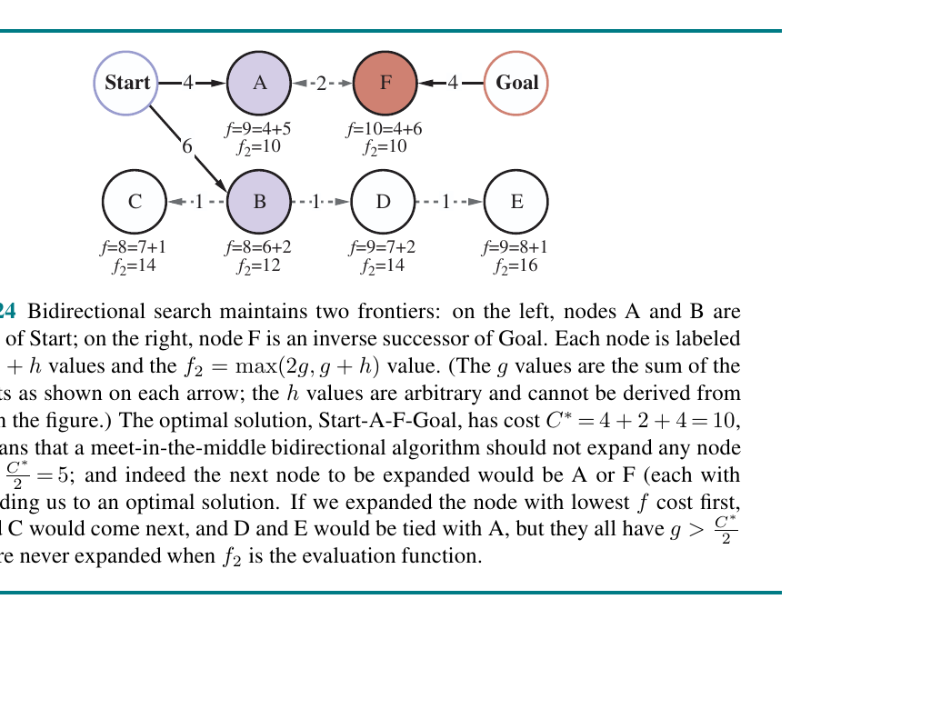
CHAPTER 3
Bidirectional Search Visual
• Two frontiers are maintained at once.
• A solution is found when frontiers connect.
• The algorithm must join two partial paths.
• Optimality depends on the evaluation function and stopping rule.
Figure source: uploaded Chapter 3 image PDF, Figure 3.24.
COMP 469 | Chapter 3: Solving Problems by Searching
42
Notes:
Teaching notes: The visual shows forward and backward reasoning. Emphasize that the backward problem must be well-defined.
Ask students: For Romania, can we search backward from Bucharest? Yes, roads are reversible. For a one-way robot action, reverse search may be harder.
Connect to later heuristic bidirectional search: once we have h values, meeting in the middle becomes more nuanced.

Slide 43
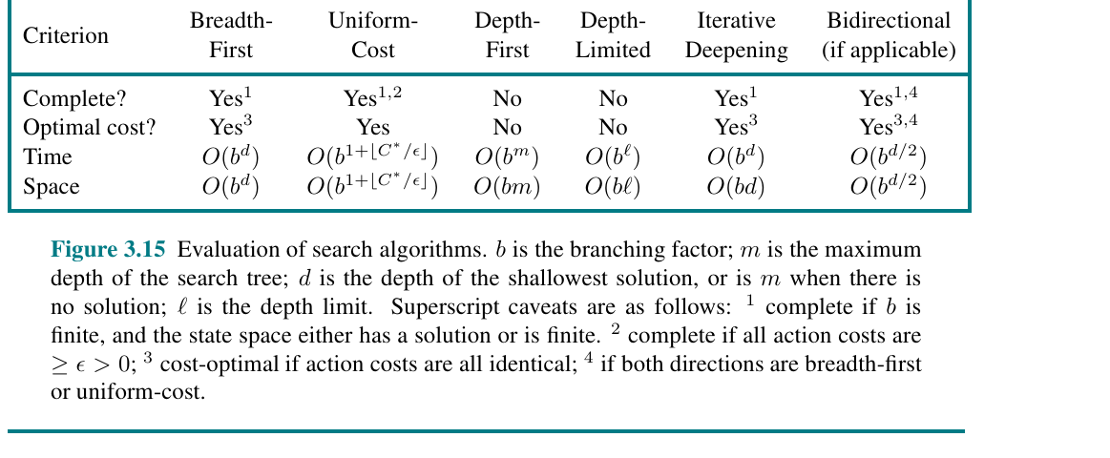
CHAPTER 3
Comparing Uninformed Search Algorithms
• No single uninformed algorithm dominates all cases.
• BFS and IDS are complete under common assumptions.
• UCS gives optimal cost for weighted problems.
• DFS saves memory but sacrifices guarantees.
• Bidirectional can be powerful when applicable.
Figure source: uploaded Chapter 3 image PDF, Figure 3.15.
COMP 469 | Chapter 3: Solving Problems by Searching
43
Notes:
Teaching notes: Use the table as a summary and a study guide. Students should be able to explain each row, not memorize symbols.
Clarify symbols: b is branching factor, d is shallowest solution depth, m is maximum depth, and l is the depth limit.
Teaching activity: Give students a problem description and ask them to choose an algorithm using this table. Require them to justify completeness, optimality, time, and space.

Slide 44
CHAPTER 3
Uninformed Search: Practical Decision Guide
Algorithm
Complete?
Optimal?
Main cost
Use when...
BFS
Yes
Unit costs
High memory
You need shallowest solution and costs are equal.
UCS
Yes
Positive costs
High memory
You need cheapest path and have no heuristic.
DFS
No in general
No
Low memory
You need a quick attempt or full traversal with safeguards.
DLS
Only within limit
No
Low memory
You know a useful depth bound.
IDS
Yes
Unit costs
Low memory
Depth is unknown and memory matters.
Bidirectional
Often
Depends
Can be much lower
Goal is explicit and reverse search is available.
COMP 469 | Chapter 3: Solving Problems by Searching
44
Notes:
Teaching notes: This slide translates the formal table into algorithm selection guidance.
Ask students to imagine three scenarios: a maze with equal steps, a road map with mileage, and a massive puzzle with unknown depth. Which algorithm fits each?
This is also a good slide for exam review. Students should not only know definitions but be able to select a strategy for a context.

Slide 45
PART 5
Informed Search Strategies
When the agent has a clue about where the goal is.
Chapter 3
COMP 469 | Chapter 3: Solving Problems by Searching
45
Notes:
Teaching notes: Transition to heuristics. Informed search adds domain-specific hints about the remaining distance to a goal.
Analogy: Uninformed search is wandering without a map. Informed search is still searching, but now you have a compass or a rough distance estimate.

Slide 46
CHAPTER 3
What Is a Heuristic?
• A heuristic function h(n) estimates the cheapest cost from node n to a goal.
• It is domain-specific information.
• It does not change the problem definition.
• It changes the order in which the algorithm explores.
• A good heuristic is cheap to compute and strongly correlated with true remaining cost.
h(n) = estimated cost of the cheapest path from n to a goal.
COMP 469 | Chapter 3: Solving Problems by Searching
46
Notes:
Teaching notes: Emphasize that a heuristic is an estimate, not magic. It can be wrong, but useful.
Analogy: Straight-line distance to a destination is a heuristic for driving distance. It is almost always optimistic because roads are not perfectly straight.
Ask: Why not use the perfect heuristic? Because computing the exact remaining cost is the original search problem.

Slide 47
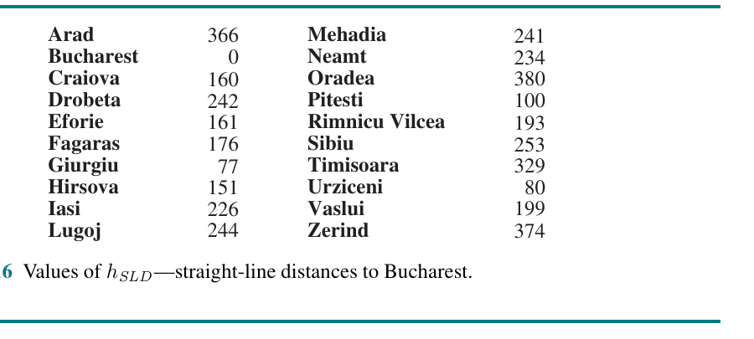
CHAPTER 3
Straight-Line Distance Heuristic hSLD
• For Romania, hSLD estimates distance to Bucharest.
• Example: hSLD(Arad) = 366.
• This information is not in the road graph itself.
• It requires outside geographic knowledge.
• Useful because it correlates with real road distance.
Figure source: uploaded Chapter 3 image PDF, Figure 3.16.
COMP 469 | Chapter 3: Solving Problems by Searching
47
Notes:
Teaching notes: Use hSLD to make heuristic information concrete. The road map gives road distances; hSLD gives direct geographic distance.
Analogy: If you know the destination is southeast, moving southeast is probably sensible, though not guaranteed to be optimal.
Important: hSLD is admissible for road distance if roads cannot be shorter than straight-line distance. It is an underestimate, which matters for A-star.

Slide 48
CHAPTER 3
Greedy Best-First Search
• Evaluation function: f(n) = h(n).
• Always expands the node that appears closest to the goal.
• Often fast when the heuristic is good.
• Not cost-optimal.
• Can be misled by local-looking progress.
Greedy asks only: which node looks closest now?
COMP 469 | Chapter 3: Solving Problems by Searching
48
Notes:
Teaching notes: Greedy best-first search is intuitive: go toward the goal. Students will often expect it to work well, so use the Romania example to show its weakness.
Analogy: Greedy search is hiking toward a mountain peak by always walking uphill. It can get stuck on a hill that is not the tallest mountain, or take a steep but inefficient path.
Connect to daily life: choosing the line at the store that looks shortest can fail if one customer has a complicated transaction.

Slide 49
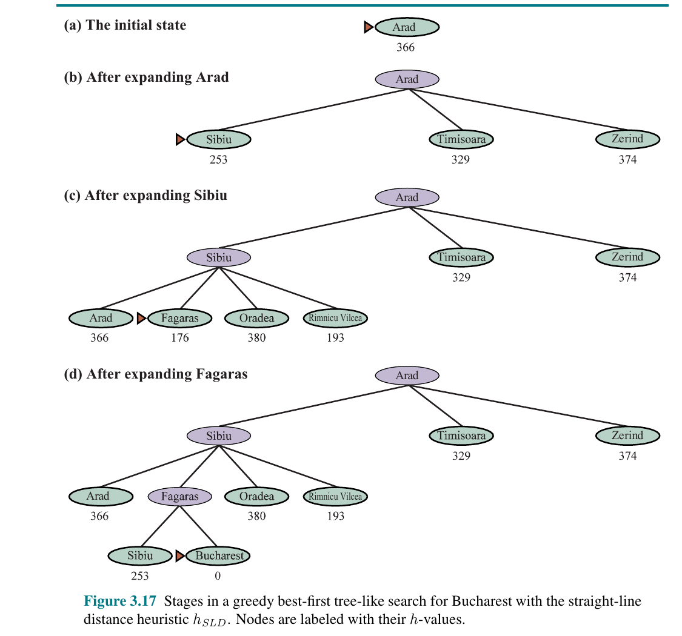
CHAPTER 3
Greedy Search on Romania
• From Arad, Sibiu has the smallest h value.
• Then Fagaras looks closest to Bucharest.
• This reaches Bucharest quickly.
• But the path is not cheapest.
• Greedy is fast, not necessarily wise.
Figure source: uploaded Chapter 3 image PDF, Figure 3.17.
COMP 469 | Chapter 3: Solving Problems by Searching
49
Notes:
Teaching notes: Trace the greedy route: Arad -> Sibiu -> Fagaras -> Bucharest. Then compare it to the cheaper route through Rimnicu Vilcea and Pitesti.
Teaching point: getting closer in straight-line distance at every step can still produce a longer road route.
Analogy: A student might choose the assignment topic that seems easiest now, but later it may require much more work. Greedy choices can hide future costs.

Slide 50
CHAPTER 3
A-Star Search
f(n) = g(n) + h(n)
A-star expands the node with the lowest estimated total solution cost: cost so far plus estimated cost remaining.
A-star is greedy plus accountability.
COMP 469 | Chapter 3: Solving Problems by Searching
50
Notes:
Teaching notes: This is the central informed-search equation. Spend time on it.
g(n) keeps the algorithm honest about what it already paid. h(n) gives direction toward the goal. Their sum estimates the full path cost through n.
Analogy: When planning a trip, you care about money already spent plus expected remaining cost. A-star refuses to ignore either.

Slide 51
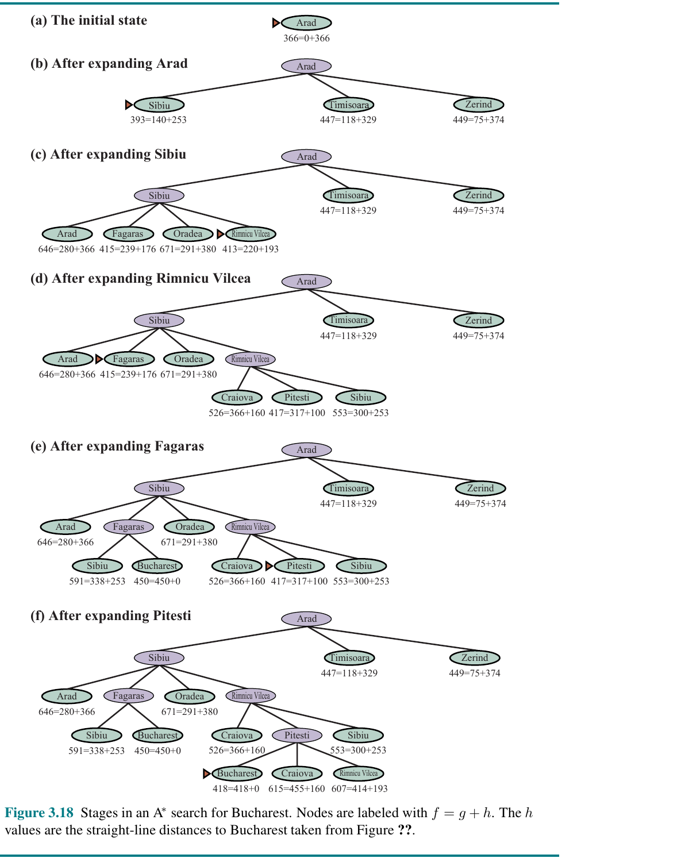
CHAPTER 3
A-Star Search on Romania
• Each node is labeled with f = g + h.
• A-star does not stop just because Bucharest first appears.
• It waits until the frontier proves the cheapest solution.
• With admissible h, A-star is complete and optimal.
• Memory is still a major limitation.
Figure source: uploaded Chapter 3 image PDF, Figure 3.18.
COMP 469 | Chapter 3: Solving Problems by Searching
51
Notes:
Teaching notes: The key teaching moment is that Bucharest can appear on the frontier before it is selected. Students often think first generated goal means solution. In A-star graph search, the selected goal with best f is what matters.
Trace why Pitesti is expanded before accepting Bucharest through Fagaras. A-star is checking whether a cheaper route may still exist.
Analogy: You do not buy the first airline ticket you see if another option still has a lower estimated total cost.

Slide 52
CHAPTER 3
Why A-Star Is Powerful
• Uses actual path cost g(n) to avoid blind greediness.
• Uses heuristic h(n) to avoid uniform exploration.
• If h is admissible, A-star never overestimates the true remaining cost.
• If h is consistent, f values behave smoothly along paths.
• A-star expands every node that could still lead to a cheaper solution.
A-star is optimal only under conditions on h(n).
COMP 469 | Chapter 3: Solving Problems by Searching
52
Notes:
Teaching notes: Keep the intuition rather than proving everything formally. A-star balances evidence from the past and hope about the future.
Analogy: Greedy search is an impatient traveler; uniform-cost search is a cautious accountant; A-star is a traveler with both a map and a budget.
Point out the tradeoff: A-star can still run out of memory because it stores a frontier and reached set.

Slide 53
CHAPTER 3
Admissibility: Optimistic Heuristics
• A heuristic is admissible if it never overestimates the true remaining cost.
• Admissible h(n) is optimistic.
• h(n) = 0 is admissible but not helpful.
• Straight-line distance is admissible for road distance when roads cannot beat geometry.
• Admissibility supports optimality for A-star.
Admissible = never too high.
COMP 469 | Chapter 3: Solving Problems by Searching
53
Notes:
Teaching notes: Use the word optimistic repeatedly. The heuristic is allowed to be low, but not too high.
Analogy: If you estimate it will take at least 20 minutes to get home, but it actually takes 30, that is optimistic. If you estimate 40, it may cause you to reject a good path.
Ask students: Is h(n)=0 admissible? Yes. Is it useful? It reduces A-star to uniform-cost search.

Slide 54
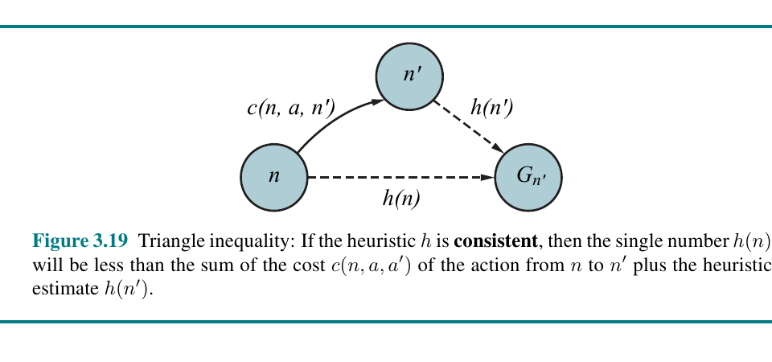
CHAPTER 3
Consistency: The Triangle Inequality
• Consistency requires h(n) <= c(n,a,n') + h(n').
• Moving one step should not make the heuristic drop too much.
• Consistent heuristics are also admissible.
• They help A-star graph search avoid reopening nodes.
• Think of it as a smoothness condition.
Figure source: uploaded Chapter 3 image PDF, Figure 3.19.
COMP 469 | Chapter 3: Solving Problems by Searching
54
Notes:
Teaching notes: This can be abstract, so use the triangle inequality analogy. A direct estimate to the goal should not exceed the cost of going to a neighbor plus that neighbor's estimate.
Analogy: In geography, the direct distance from your location to the goal cannot be greater than driving to a nearby city plus the direct distance from that city to the goal.
Emphasize that consistency is stronger and more convenient than admissibility for graph search.

Slide 55
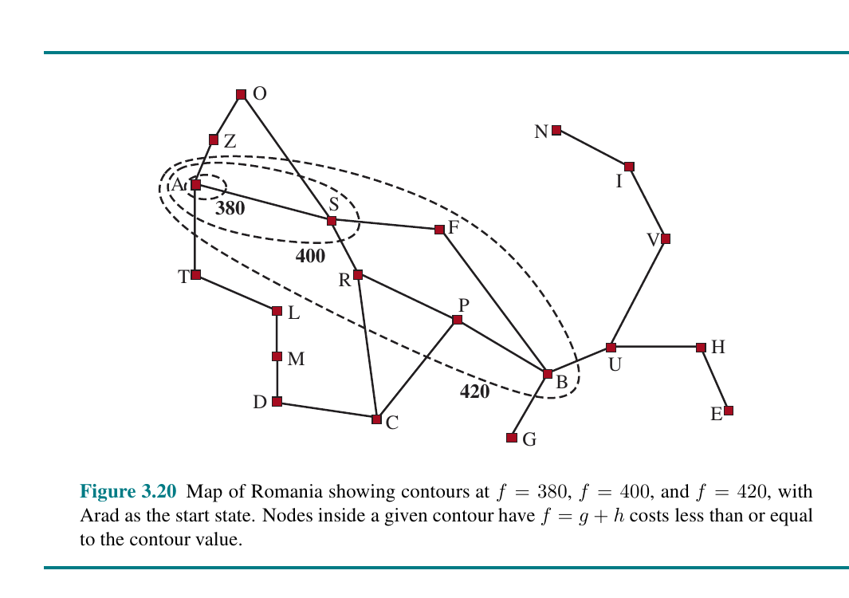
CHAPTER 3
Search Contours: How A-Star Expands
• A-star expands nodes in increasing f-value contours.
• A better heuristic focuses contours toward the goal.
• Every node with f(n) below the optimal solution cost must be considered.
• Contours explain both power and cost of A-star.
• Weak heuristics make contours wide.
Figure source: uploaded Chapter 3 image PDF, Figure 3.20.
COMP 469 | Chapter 3: Solving Problems by Searching
55
Notes:
Teaching notes: Search contours are a visual way to explain A-star's behavior. Uniform-cost search expands circles of cost. A-star bends those circles toward the goal.
Analogy: Imagine floodwater spreading across a landscape, but a slope pulls it toward the destination. The heuristic creates the slope.
Use this to prepare students for heuristic accuracy: better h means fewer unnecessary contours.

Slide 56
CHAPTER 3
Weighted A-Star and Satisficing Search
• Weighted A-star uses f(n) = g(n) + W h(n), usually W > 1.
• It pushes search more aggressively toward the goal.
• It may find solutions faster.
• It can sacrifice optimality.
• Satisficing search accepts a good enough solution when exact optimality is too expensive.
Optimality is valuable, but not always affordable.
COMP 469 | Chapter 3: Solving Problems by Searching
56
Notes:
Teaching notes: This slide introduces an engineering tradeoff. Sometimes we prefer a quick good route over a slow perfect route.
Analogy: Navigation apps often offer a route that is close to optimal quickly. You do not want your GPS to spend an hour proving the absolute best path.
Connect to real AI: many systems operate under time limits, memory limits, or deadlines. Perfect rationality is often computationally infeasible.

Slide 57
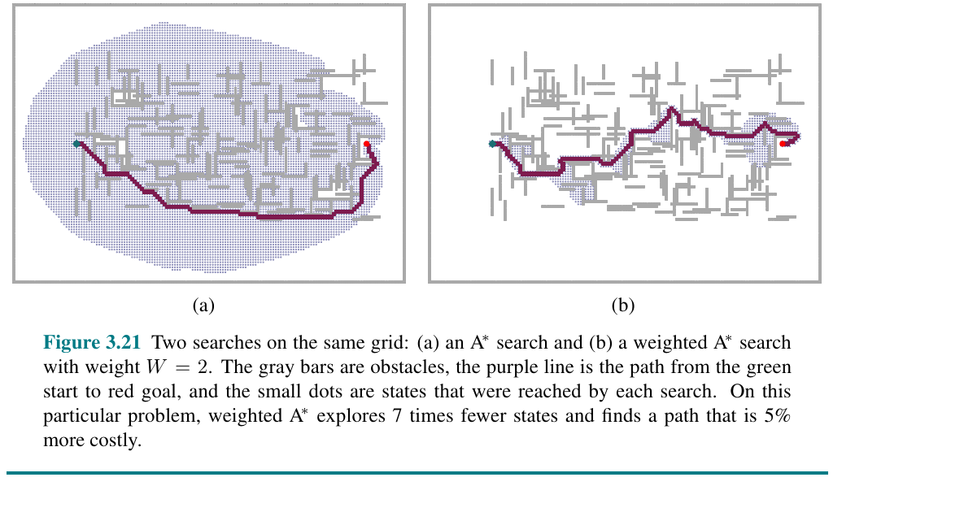
CHAPTER 3
Weighted A-Star Visual
• Weighted A-star may explore far fewer states.
• The path found can be slightly more costly.
• This is a controlled tradeoff between speed and quality.
• A larger weight means more greediness.
• Useful when a near-optimal answer is acceptable.
Figure source: uploaded Chapter 3 image PDF, Figure 3.21.
COMP 469 | Chapter 3: Solving Problems by Searching
57
Notes:
Teaching notes: Use the visual comparison: standard A-star explores broadly, while weighted A-star is more focused.
Ask students: Would you accept a path that is 5 percent longer if it is found 7 times faster? In many real systems, yes.
Analogy: A student studying for an exam may focus on the most likely topics. That is not exhaustive, but it can be efficient under time pressure.

Slide 58
CHAPTER 3
The Memory Problem in A-Star
• A-star stores the frontier and reached table.
• The number of stored nodes can be enormous.
• Memory often becomes the limiting resource.
• Removing duplicate storage can help but does not solve the main issue.
• Memory-bounded variants trade time for space.
A-star can be theoretically elegant and practically memory-hungry.
COMP 469 | Chapter 3: Solving Problems by Searching
58
Notes:
Teaching notes: This is a good place to remind students that asymptotic analysis is not just theory. Running out of memory is a practical failure mode.
Analogy: A-star is like a detective who keeps every clue and every possible lead on the wall. Eventually the wall runs out of space.
Connect to labs: students may see algorithms slow down or consume memory on larger 8-puzzle instances.

Slide 59
CHAPTER 3
Memory-Bounded Search
• IDA-star: iterative deepening version of A-star using f-cost limits.
• RBFS: recursive best-first search remembers best alternatives.
• SMA-star: simplified memory-bounded A-star drops the worst leaf when memory is full.
• These methods can solve problems that plain A-star cannot fit in memory.
• The price is repeated work and possible regeneration of nodes.
Memory-bounded search asks: what should I forget, and what should I remember about it?
COMP 469 | Chapter 3: Solving Problems by Searching
59
Notes:
Teaching notes: This slide introduces the family of algorithms without requiring students to implement all of them.
Analogy: If your desk is small, you cannot keep every document open. You must close some files, but you leave sticky notes telling you whether they are worth reopening later.
Emphasize the time-space tradeoff: memory-bounded search saves storage but may redo work.

Slide 60
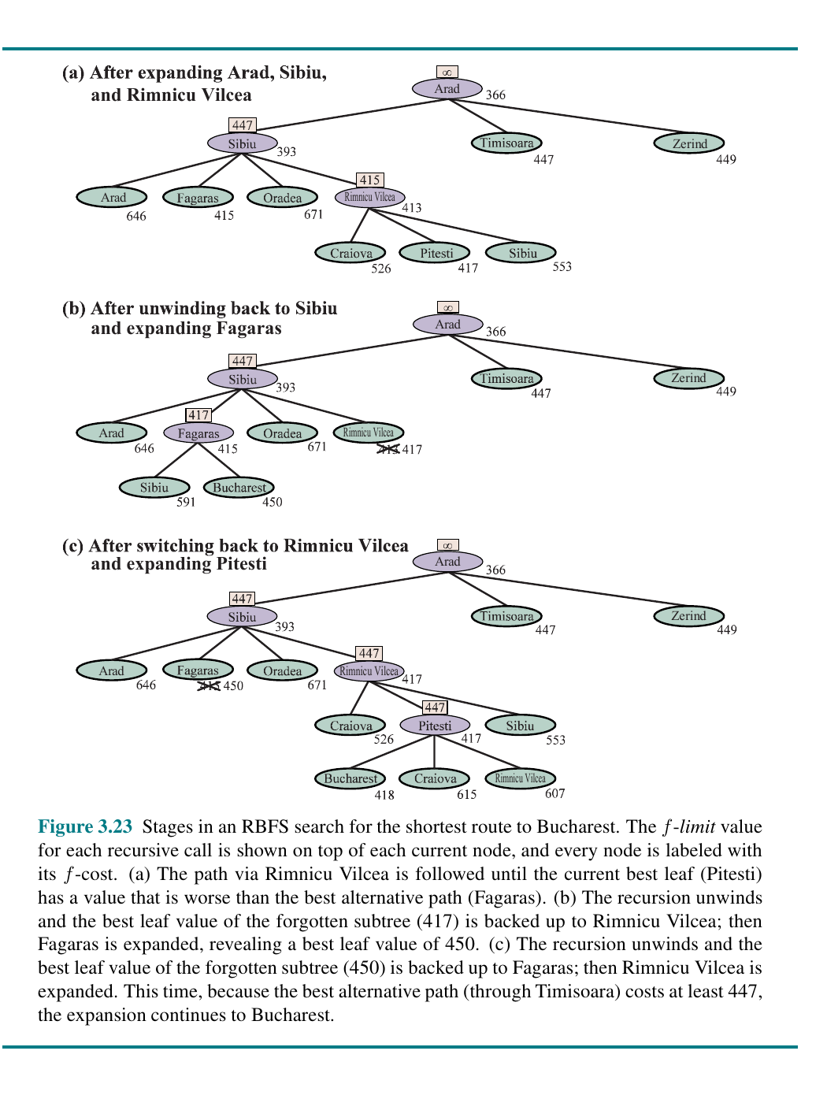
CHAPTER 3
RBFS: Remember the Best Alternative
• Recursive best-first search follows the current best path.
• It keeps an f-limit based on the best alternative path.
• When a path becomes worse than an alternative, recursion unwinds.
• It uses much less memory than A-star.
• It may revisit parts of the tree.
Figure source: uploaded Chapter 3 image PDF, Figure 3.23.
COMP 469 | Chapter 3: Solving Problems by Searching
60
Notes:
Teaching notes: RBFS can be difficult, so teach the intuition only unless the course requires details. It acts like a depth-first search that remembers the best reason to backtrack.
Analogy: Hiking with a note: "If this trail looks worse than the trail I skipped, turn around." The f-limit is that note.
Use the figure to show switching between paths as backed-up f-values change.

Slide 61
CHAPTER 3
Bidirectional Heuristic Search
• Combines two-frontier search with heuristic evaluation.
• The simple A-star rule is not enough to guarantee optimality in both directions.
• Some methods reason about pairs of frontier nodes.
• Can help with average heuristics.
• With strong heuristics, ordinary A-star may already be highly focused.
Meeting is not enough; the algorithm must prove no cheaper meeting remains.
COMP 469 | Chapter 3: Solving Problems by Searching
61
Notes:
Teaching notes: This slide is advanced but useful for completeness. The main message is that bidirectional search is not automatically solved by adding h values.
Analogy: Two hikers both have compasses, but they still need a clear rule for when meeting means the best route has been proven.
Mention that Chapter 3 presents more sophisticated stopping and evaluation ideas for bidirectional best-first search.

Slide 62
PART 6
Heuristic Functions
How do we make good guesses?
Chapter 3
COMP 469 | Chapter 3: Solving Problems by Searching
62
Notes:
Teaching notes: Transition from algorithms that use heuristics to the design of the heuristics themselves.
Frame the question: If h(n) is so important, where does it come from? This section answers through accuracy, relaxation, subproblems, landmarks, and learning.

Slide 63
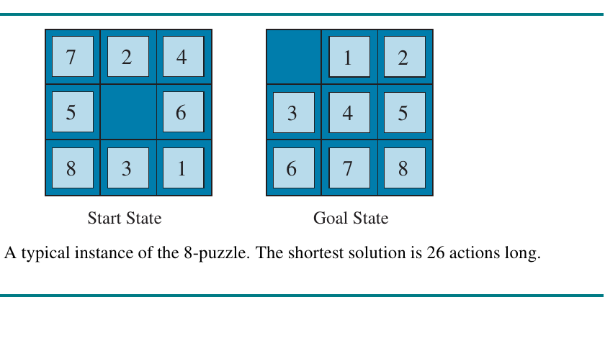
CHAPTER 3
8-Puzzle as a Heuristic Testbed
• The 8-puzzle is small but combinatorially rich.
• Goal: slide tiles into the target arrangement.
• Each move swaps the blank with a neighbor.
• Unit action cost is common.
• Different heuristics can be compared experimentally.
Figure source: uploaded Chapter 3 image PDF, Figure 3.25.
COMP 469 | Chapter 3: Solving Problems by Searching
63
Notes:
Teaching notes: Reintroduce the 8-puzzle as the main heuristic example. Students can visually inspect states and calculate simple heuristic values.
Ask: What makes this problem hard? The local move constraint: you cannot pick up a tile and put it anywhere.
Analogy: Rearranging furniture in a tiny room where there is only one empty spot. You may know where each item belongs, but constraints make getting there difficult.

Slide 64
CHAPTER 3
Heuristic h1: Misplaced Tiles
• Counts how many tiles are not in their goal positions.
• Ignores the blank in the usual formulation.
• Easy and fast to compute.
• Admissible: each misplaced tile needs at least one move.
• Weak: it ignores how far a tile is from its goal.
h1 is simple and admissible, but not very informative.
COMP 469 | Chapter 3: Solving Problems by Searching
64
Notes:
Teaching notes: Have students compute h1 on the displayed 8-puzzle state. This makes the idea concrete.
Analogy: Checking a messy bookshelf by counting how many books are not on the right shelf. It tells you something, but not how far each book must move.
Emphasize that cheap heuristics may save computation per node but cause many more nodes to be expanded.

Slide 65
CHAPTER 3
Heuristic h2: Manhattan Distance
• For each tile, count horizontal plus vertical distance to its goal square.
• Sum the distances over all tiles.
• Usually much more informative than misplaced tiles.
• Admissible for the 8-puzzle.
• Consistent because each move changes the sum by at most one.
h2 captures distance, not just wrongness.
COMP 469 | Chapter 3: Solving Problems by Searching
65
Notes:
Teaching notes: Demonstrate Manhattan distance with one tile. Draw row and column movement: no diagonals, no teleportation.
Analogy: In a city grid, Manhattan distance counts blocks east-west plus blocks north-south. It ignores traffic and one-way streets, but it is a useful lower bound.
Ask students: Why is Manhattan distance at least as large as misplaced tiles? A misplaced tile has distance at least one; a correctly placed tile has distance zero.

Slide 66
CHAPTER 3
Dominance and Effective Branching Factor
• If h2(n) >= h1(n) for all nodes and both are admissible, h2 dominates h1.
• A dominating heuristic usually expands fewer nodes.
• Effective branching factor b* estimates how quickly the search tree grows in practice.
• Good heuristics push b* closer to 1.
• Heuristic value must be worth its computation time.
A good heuristic reduces the search tree without losing optimality.
COMP 469 | Chapter 3: Solving Problems by Searching
66
Notes:
Teaching notes: Dominance is a key exam concept. A heuristic that is safely higher is better because it rules out more hopeless nodes.
Analogy: Two weather forecasts are both never too pessimistic, but one is more accurate. You prefer the more accurate one because it gives better guidance.
Explain effective branching factor as the observed branching factor that would produce the same number of generated nodes at the same solution depth.

Slide 67
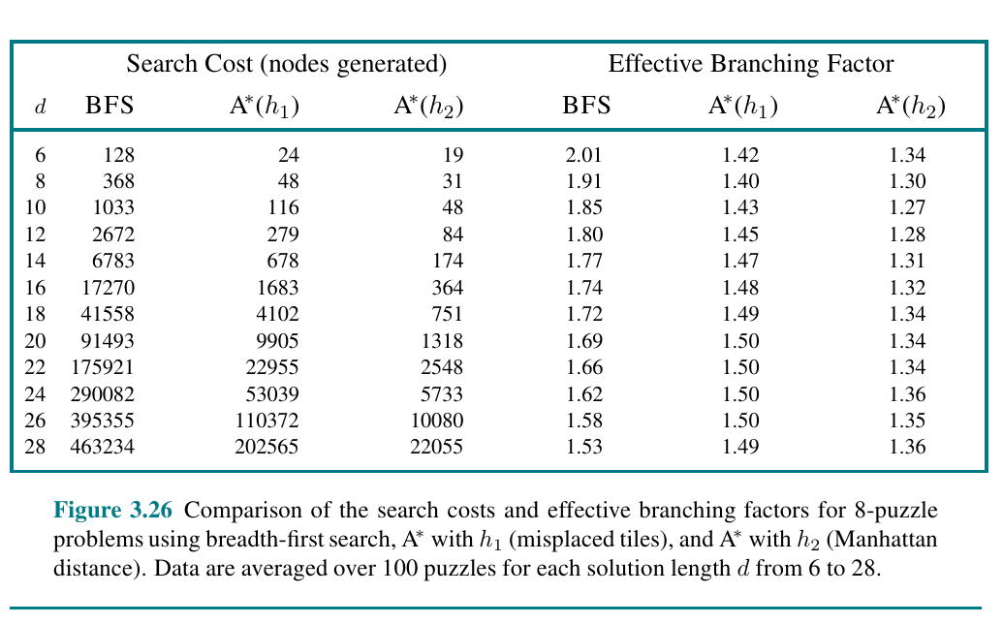
CHAPTER 3
Heuristic Accuracy Changes Search Cost
• Breadth-first search generates many more nodes.
• A-star with misplaced tiles improves substantially.
• A-star with Manhattan distance improves even more.
• The advantage grows with solution depth.
• This is why heuristic design matters.
Figure source: uploaded Chapter 3 image PDF, Figure 3.26.
COMP 469 | Chapter 3: Solving Problems by Searching
67
Notes:
Teaching notes: The table makes heuristic value concrete. Point out that the number of generated nodes can differ by orders of magnitude.
Ask students to compare one row, such as solution length 20 or 24. How many nodes does BFS generate versus A-star with Manhattan distance?
Analogy: A good heuristic is like having a sharper flashlight in a dark warehouse. You still search, but you avoid many irrelevant aisles.

Slide 68
CHAPTER 3
Generating Heuristics from Relaxed Problems
• A relaxed problem removes one or more constraints from the original problem.
• The relaxed problem is easier to solve.
• Its optimal solution cost is a lower bound for the original problem.
• Therefore it can be an admissible heuristic.
• Misplaced tiles and Manhattan distance can both be explained this way.
Relaxation gives optimistic estimates automatically.
COMP 469 | Chapter 3: Solving Problems by Searching
68
Notes:
Teaching notes: This is one of the deepest ideas in the chapter. The heuristic is not arbitrary; it can be derived from a simpler version of the same problem.
Analogy: Estimate how long it takes to move furniture by pretending walls do not exist. That estimate is too low, but it gives a useful lower bound.
For the 8-puzzle, if a tile could move anywhere in one step, misplaced tiles would be exact. If a tile could move one square in any direction without needing the blank, Manhattan distance would be exact.

Slide 69
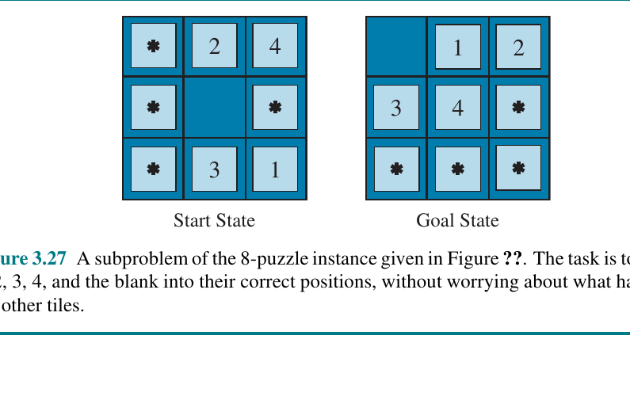
CHAPTER 3
Subproblems and Pattern Databases
• Solve a smaller subproblem exactly ahead of time.
• Store exact costs in a pattern database.
• Use the stored cost as a heuristic during search.
• Can be very powerful but consumes memory.
• Common in puzzles such as sliding tiles and Rubik's Cube.
Figure source: uploaded Chapter 3 image PDF, Figure 3.27.
COMP 469 | Chapter 3: Solving Problems by Searching
69
Notes:
Teaching notes: Explain pattern databases as lookup tables for solved subproblems. They trade precomputation and memory for faster search later.
Analogy: Instead of solving every math fact from scratch, you memorize a multiplication table. Pattern databases are like memorized solution costs.
Point out the tradeoff: memory again matters. The heuristic may be excellent but expensive to store.

Slide 70
CHAPTER 3
Landmarks, Abstraction, and Hierarchies
• Landmarks are states or subgoals that every solution must pass through.
• Hierarchical search solves coarse problems before fine details.
• Route planners exploit highways, regions, and important junctions.
• Abstraction can provide exponential speedups when valid.
• These ideas connect search to planning and real systems.
Real search systems rarely use only one textbook algorithm.
COMP 469 | Chapter 3: Solving Problems by Searching
70
Notes:
Teaching notes: Use route planning as the analogy. To drive across a country, you first choose major highways or regions, then local streets.
Analogy: Planning a degree path: first choose the major, then required courses, then weekly study schedule. A hierarchy makes the problem manageable.
Connect to AI engineering: practical systems often combine heuristics, precomputed data, landmarks, and hierarchy.

Slide 71
CHAPTER 3
Learning to Search Better
• A system can learn which states are promising from experience.
• It can learn heuristic values from solved examples.
• It can learn macro-actions or useful subgoals.
• It can tune tradeoffs between speed and solution quality.
• This connects classical search to modern machine learning.
Learning can improve the heuristic, the abstraction, or the action choices.
COMP 469 | Chapter 3: Solving Problems by Searching
71
Notes:
Teaching notes: This slide helps students connect classic AI to modern AI. Search and learning are not enemies; they often cooperate.
Analogy: A novice solves a puzzle by trial and error. An expert recognizes patterns and knows promising moves. Learning turns experience into better search guidance.
Mention that later chapters on learning and reinforcement learning revisit this idea: experience improves future decision-making.

Slide 72
CHAPTER 3
Algorithm Cheat Sheet
Algorithm
Complete?
Optimal?
Main cost
Use when...
BFS
Yes
Unit costs
O(b^d) space
Small unit-cost problems, shallow goals.
UCS
Yes
Yes
Cost contours
Weighted graphs with no heuristic.
DFS
No general
No
Low space
Memory-limited exploration with safeguards.
IDS
Yes
Unit costs
Repeated DFS
Unknown depth, limited memory.
Greedy
Finite graphs
No
Heuristic driven
Fast approximate search.
A-star
Yes
Yes if h admissible
Memory heavy
Optimal path with a good heuristic.
Weighted A-star
Usually
No exact
Fewer nodes
Near-optimal answers under time pressure.
COMP 469 | Chapter 3: Solving Problems by Searching
72
Notes:
Teaching notes: This cheat sheet is intentionally practical. It can be used near the end of lecture or as a review slide before a quiz.
Ask students to cover the algorithm names and infer which row describes which algorithm. This checks conceptual understanding.
Emphasize that algorithm choice is a design decision, not a memorization exercise.

Slide 73
CHAPTER 3
Common Misconceptions to Catch Early
• Misconception: a state and a node are the same thing.
• Misconception: the first goal generated is always the answer.
• Misconception: greedy search and A-star are the same.
• Misconception: an admissible heuristic must be accurate.
• Misconception: BFS is always better because it is complete.
• Misconception: more heuristic computation is always worth it.
Misconceptions are not failures; they are checkpoints for deeper understanding.
COMP 469 | Chapter 3: Solving Problems by Searching
73
Notes:
Teaching notes: Use this slide proactively. These are the mistakes students frequently make on homework and exams.
Ask students to correct each statement in pairs. Example: a node contains a state plus path information. The first generated goal might not be optimal in UCS or A-star.
Analogy for admissibility: A person who always underestimates travel time is admissible in the technical sense, but may still be a poor planner if the estimate is too low to be useful.

Slide 74
CHAPTER 3
Board Work: Trace One Problem Three Ways
• Give students a tiny weighted graph with one start and one goal.
• Trace BFS: order by depth.
• Trace UCS: order by g(n).
• Trace greedy: order by h(n).
• Trace A-star: order by g(n) + h(n).
• Compare first solution found and optimality.
Classroom rule: no answer without showing the frontier.
COMP 469 | Chapter 3: Solving Problems by Searching
74
Notes:
Teaching notes: This is a suggested live teaching activity. Draw a small graph with 5 to 7 nodes. Give edge costs and heuristic values.
Have students maintain the frontier on the board. For each expansion, ask: what comes off the frontier, what gets added, and how is it ordered?
This activity is valuable because it forces students to see that the algorithm is not the graph. The same graph behaves differently under different frontier policies.

Slide 75
CHAPTER 3
Lab Bridge: How the Chapter Maps to Notebooks
• Lab 01: problem-solving agent cycle and route planning.
• Lab 02: search trees, frontiers, reached tables, redundant paths.
• Lab 03: BFS, UCS, DFS, depth-limited, IDS, bidirectional search.
• Lab 04: greedy best-first, A-star, weighted A-star, hSLD.
• Lab 05: 8-puzzle heuristics, Manhattan distance, effective branching factor.
Lecture gives vocabulary; lab makes the search visible.
COMP 469 | Chapter 3: Solving Problems by Searching
75
Notes:
Teaching notes: Use this slide to help students connect lecture and lab. Tell them the notebooks are not separate from the chapter; they are visual versions of the chapter's algorithms.
Suggested instruction: before each lab, ask students to identify which part of the chapter the notebook implements.
This also helps students who struggle with code: they can use the conceptual structure from lecture to read the notebook cells.

Slide 76
CHAPTER 3
In-Class Activity: Students as the Frontier
• Put labels A, B, C, D, E, F on students or sticky notes.
• Give each label a depth, g value, and h value.
• For BFS, line students up by depth/FIFO order.
• For UCS, reorder by g value.
• For greedy, reorder by h value.
• For A-star, reorder by g + h.
Kinesthetic analogy: the algorithm is the rule for who stands at the front of the line.
COMP 469 | Chapter 3: Solving Problems by Searching
76
Notes:
Teaching notes: This activity makes an abstract data structure physical. It is especially useful for students new to algorithms.
Ask one student to be the priority queue manager. When a node is expanded, hand them child nodes and ask where they belong in line.
Debrief: the graph did not change; only the ordering policy changed. That is the central idea of the chapter.

Slide 77
CHAPTER 3
Mini-Assessment / Exit Ticket
• Define a search problem for a robot moving on a grid.
• Explain why a search tree can contain duplicate states.
• Choose BFS, UCS, DFS, IDS, greedy, or A-star for a scenario and justify it.
• Given g and h values, compute f and select the next node.
• Say whether a heuristic is admissible and why.
• Compare misplaced tiles and Manhattan distance for one 8-puzzle state.
Exit ticket target: students should explain, not just name algorithms.
COMP 469 | Chapter 3: Solving Problems by Searching
77
Notes:
Teaching notes: These questions can be used as an end-of-class exit ticket or as review prompts at the start of the next class.
For a quick version, pick three: define a problem, compute A-star priority, and explain one algorithm tradeoff.
These questions test conceptual transfer, not just vocabulary recall.

Slide 78
CHAPTER 3
Suggested 75-Minute Teaching Plan
• 0-10 min: motivation, assumptions, and problem formulation.
• 10-25 min: state-space graph, search tree, frontier, reached.
• 25-45 min: BFS, UCS, DFS, IDS, bidirectional search.
• 45-60 min: heuristics, greedy, A-star, admissibility.
• 60-70 min: 8-puzzle heuristics and relaxed problems.
• 70-75 min: exit ticket and lab bridge.
Teaching priority: do fewer algorithms deeply rather than many algorithms superficially.
COMP 469 | Chapter 3: Solving Problems by Searching
78
Notes:
Teaching notes: This slide is primarily for instructor planning. If you have a longer class period, expand the trace activities and lab demos.
For a two-hour session, add a 15-minute live coding demo of frontier updates, a 10-minute small-group algorithm selection exercise, and a 15-minute 8-puzzle heuristic calculation.
If students are struggling, slow down at state versus node and frontier policy. Those are prerequisites for everything else.

Slide 79
CHAPTER 3
References and Useful URLs
• AIMA textbook site: https://aima.cs.berkeley.edu/
• AIMA Python code: https://github.com/aimacode/aima-python
• Berkeley CS188 AI course: https://inst.eecs.berkeley.edu/~cs188/sp26/
• Jupyter documentation: https://jupyter.org/documentation
• Python virtual environments: https://docs.python.org/3/library/venv.html
• Course labs: use the Chapter 3 notebooks and README provided with this module.
Reference URLs are included for study, not as replacements for lecture and lab work.
COMP 469 | Chapter 3: Solving Problems by Searching
79
Notes:
Teaching notes: Point students to resources carefully. The book site and AIMA Python repository are useful for students who want alternative implementations.
Warn students not to copy code blindly. The goal is to understand search behavior: frontier, expansion, path cost, and heuristic guidance.
For office hours, recommend that students bring one trace table showing expanded node and frontier after each step. That makes debugging search algorithms much easier.

Slide 80
CHAPTER 3
Chapter 3 Concept Map
Problem-solving agent
Problem formulation
State-space graph
Search tree
Frontier policy
Uninformed search
Informed search
Heuristic h(n)
Tradeoffs: complete, optimal, time, space
A-star: g + h
COMP 469 | Chapter 3: Solving Problems by Searching
80
Notes:
Teaching notes: Use this as the final synthesis slide. Walk through the map left to right: an agent formulates a problem, the problem defines a state-space graph, the algorithm builds a search tree, and the frontier policy determines behavior.
Then split into uninformed and informed search. Informed search depends on h(n), and A-star is the key algorithm that combines g(n) and h(n).
Close with the main lesson: search is systematic look-ahead under a model. The art is choosing the right representation, frontier policy, and heuristic for the task.

